Slide 1
Unit - 1
Introduction to MS Excel
Part-2

Slide 2
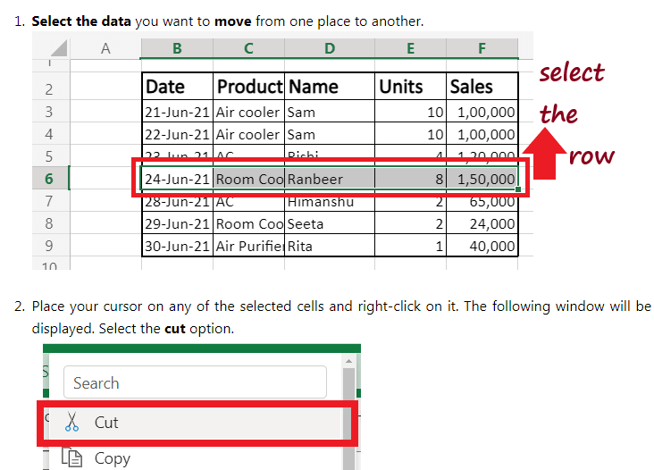
Move data in Excel-Move Data using Cut and Insert

Slide 3
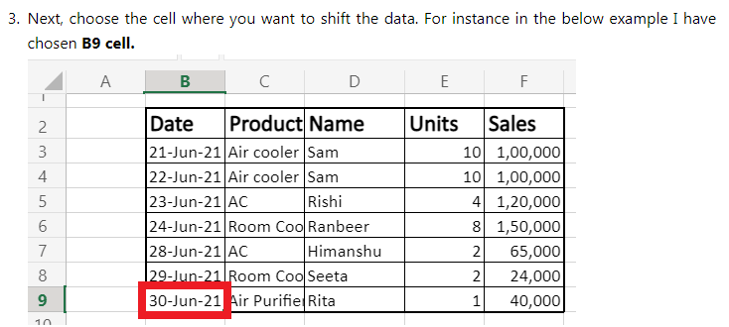

Slide 4
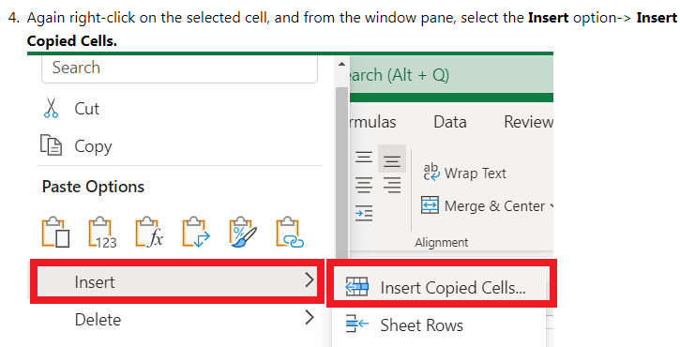

Slide 5
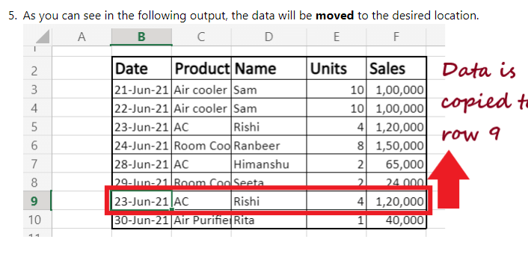

Slide 6
Paste special method
Copy only values without color formatting
Copy with column width
Copy only values not formula

Slide 7
Copy only values without color formatting
Sometimes, we apply color formatting on Excel data to analyze the data based upon certain conditions.
In case If we need this data at another place but without color formatting, the simple copy-paste method does not work. It copies the data along with color formatting.
We can use Paste Special option to keep the only data without color formatting. Copy the targeted data and paste it using Paste Special method.

Slide 8
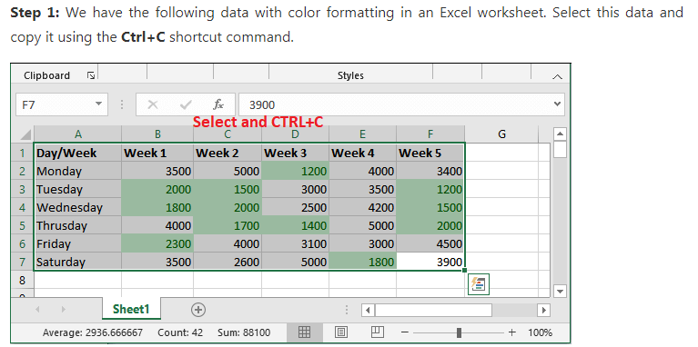

Slide 9
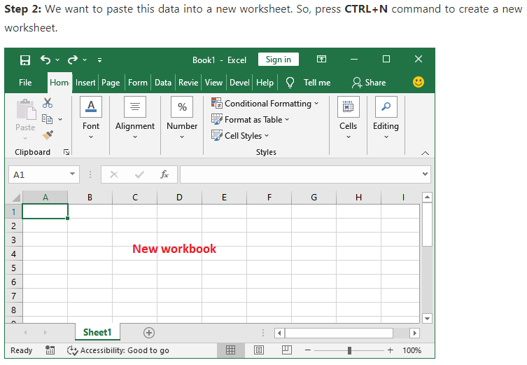

Slide 10
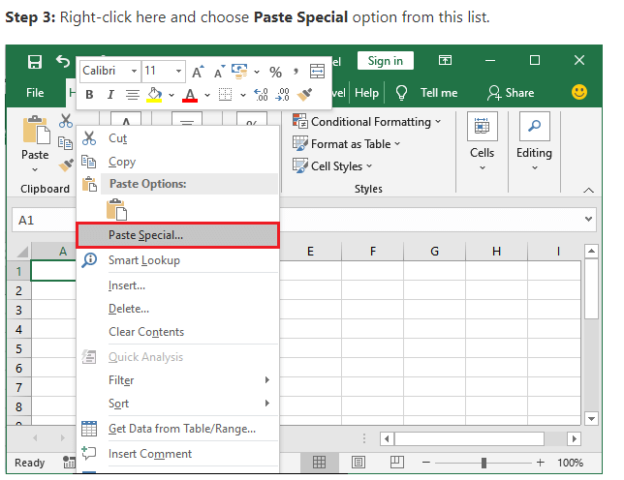

Slide 11
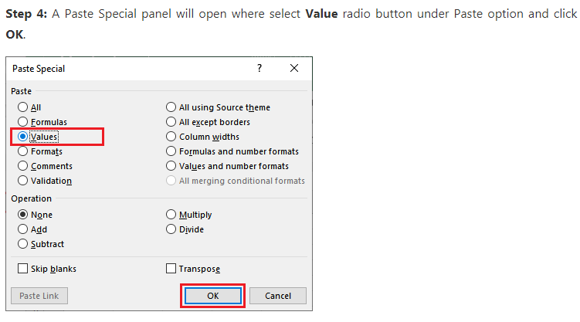

Slide 12
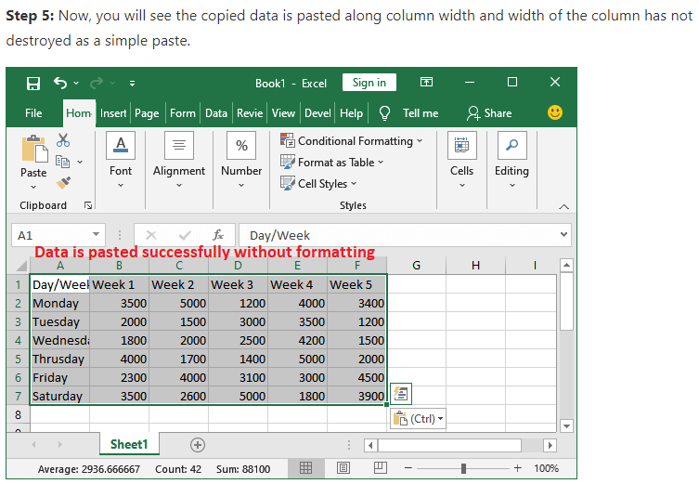

Slide 13
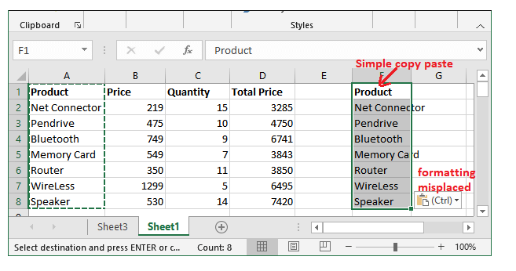
Copy with column width

Slide 14
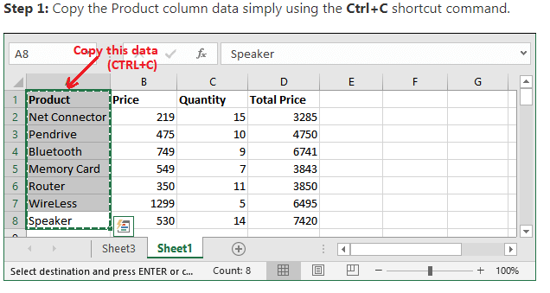

Slide 15
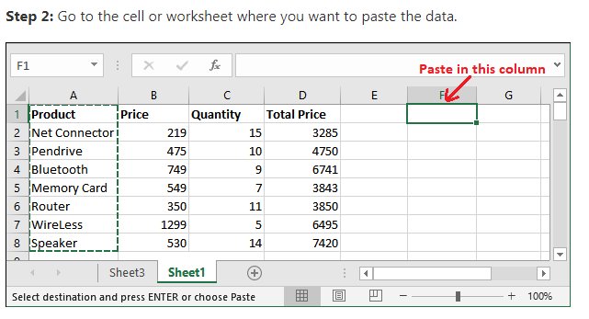

Slide 16
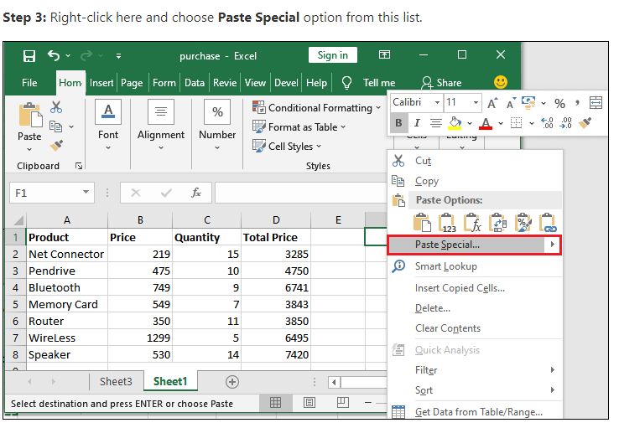

Slide 17
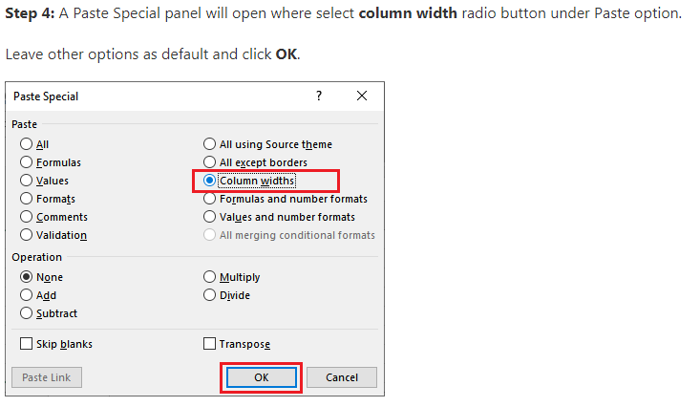

Slide 18
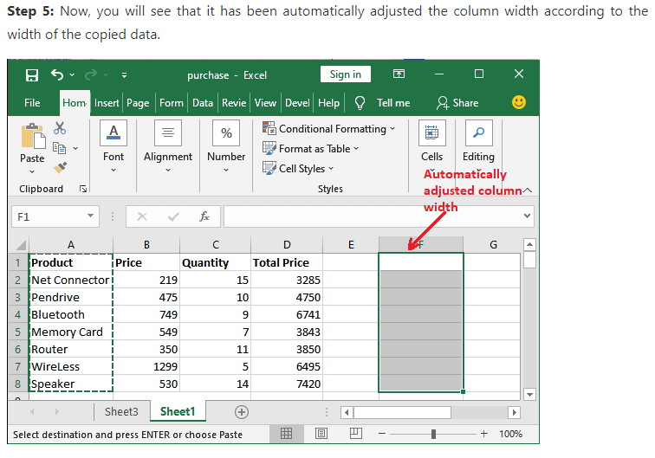

Slide 19
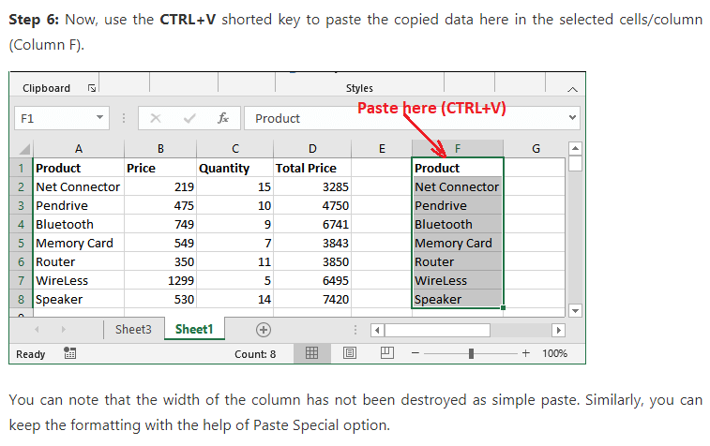

Slide 20
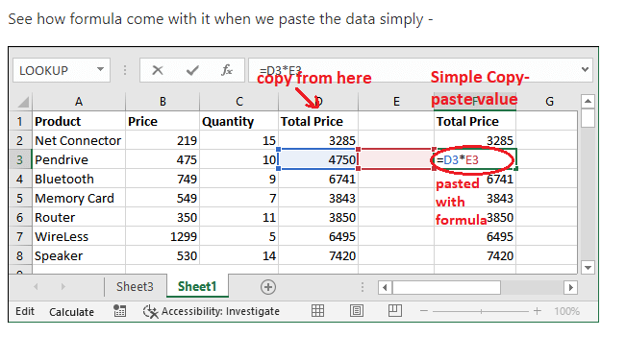
Copy only value not formula

Slide 21
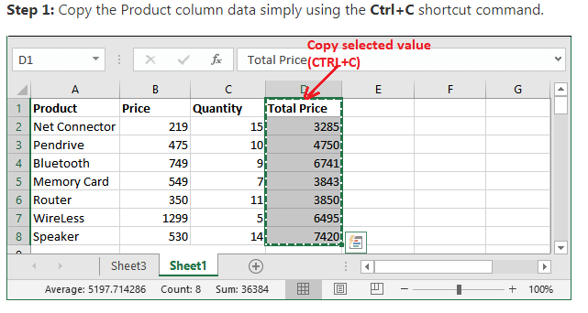

Slide 22
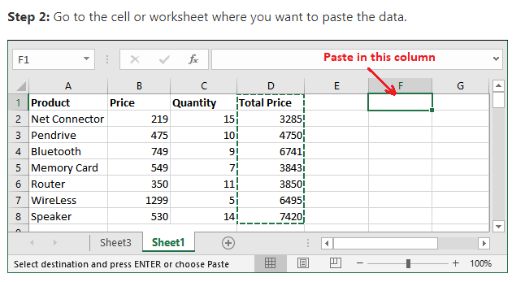

Slide 23
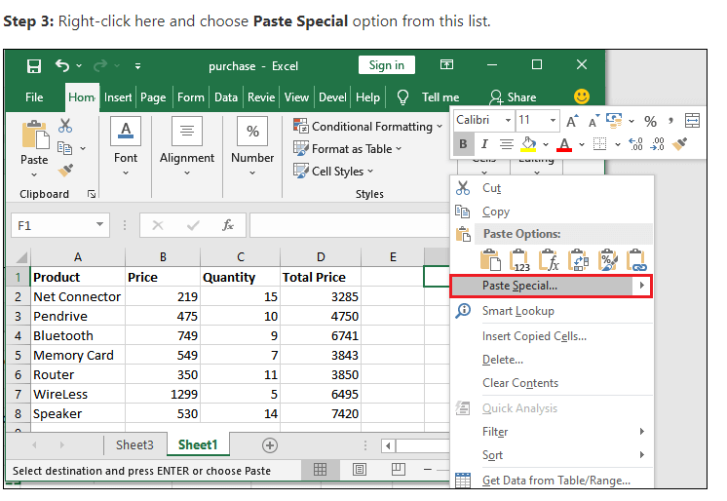

Slide 24
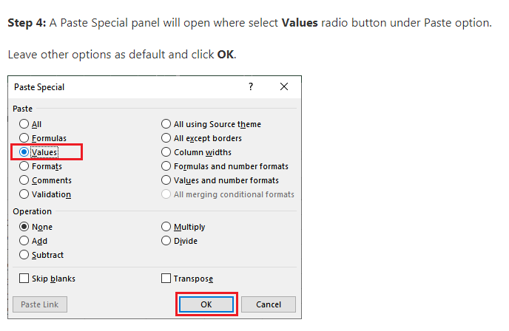

Slide 25
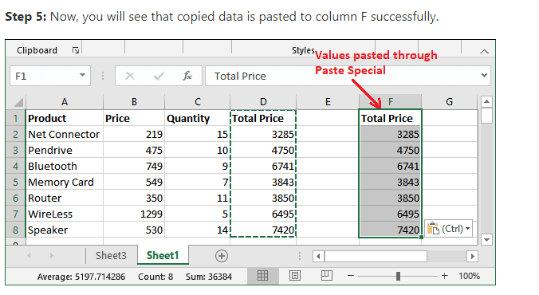

Slide 26
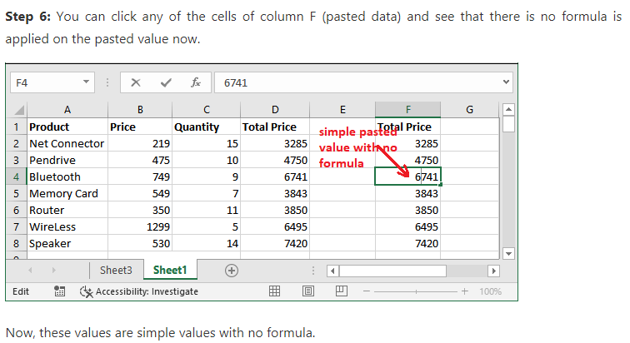

Slide 27
